Slide 1
AI Health and Energy Monitoring for Women Using CLO 3D and Silk Fabric Integration
TEAM MEMBERS:​
WEBSITE:
JHOSPIN D [7376232FT106]
POOJA S [7376232FT115]
TAMILARASI P [7376232FT120]
https://lovable.dev/preview/EfVF6w4yZoCZXkJtHQKxenvWFOtLVXGR

Slide 2
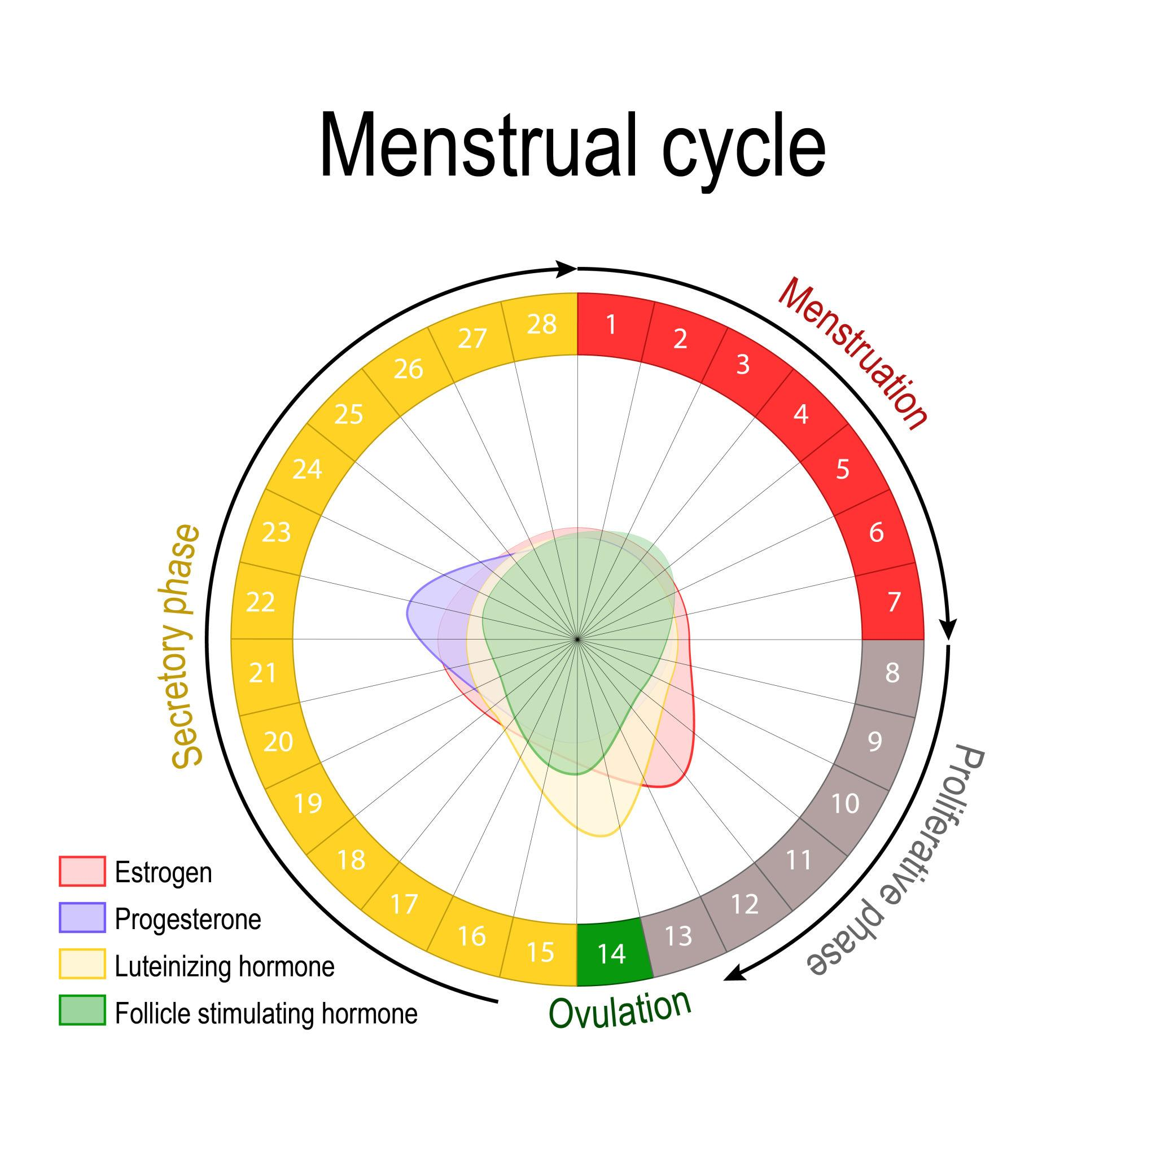
Motivation of the Project ​
Women undergo continuous biological and hormonal changes that significantly influence their energy levels, emotional state, and daily productivity, especially during menstrual cycles
Most existing health and productivity tools follow a one-size-fits-all approach and fail to adapt to individual physiological and cyclic variations
This lack of personalization often results in increased stress, fatigue, and reduced health awareness among women
There is a strong need for an intelligent, real-time, and personalized AI-based wellness support system that adapts to individual patterns and supports better health and productivity

Slide 3
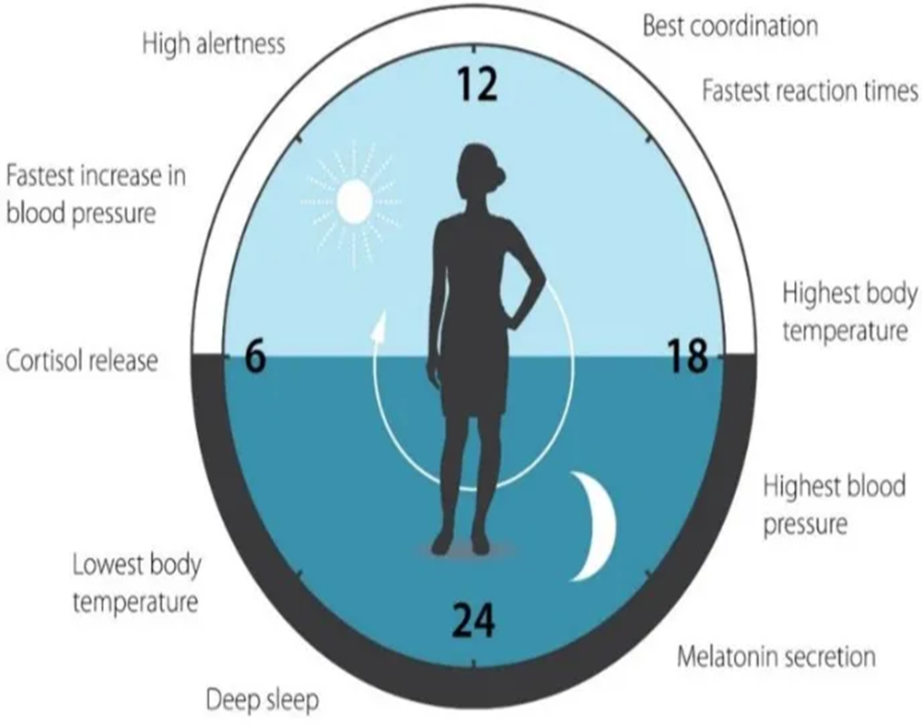
Problem Statement
Women experience cyclic changes in energy, stress, and emotional state
Menstrual cycles and lifestyle stress significantly affect daily productivity
Existing health & productivity tools treat all days the same
Lack of personalized, real-time support leads to fatigue and burnout.

Slide 4
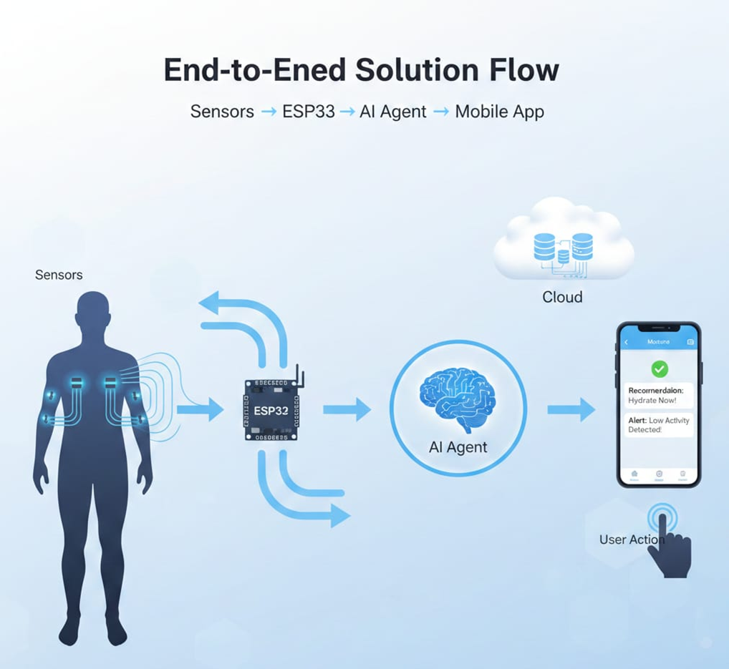
Solution
AI-assisted health and energy monitoring system
Uses physiological sensors (heart rate, temperature, activity)
Continuously analyzes real-time data
Learns personalized user baselines over time
Predicts energy and emotional states
Provides alerts and recommendations through a mobile app

Slide 5

Objectives
To develop an AI-assisted health monitoring system that continuously observes physiological signals in real time
To learn personalized baseline patterns for each user instead of relying on fixed thresholds
To predict energy and emotional states using physiological data and pattern analysis
To provide timely alerts and personalized recommendations for improved wellness and productivity
To support women through dynamic biological and hormonal changes using adaptive AI logic
To design an explainable, ethical, and user-centric wellness support system

Slide 6
Abstract​
Women experience biological and hormonal changes that affect energy, emotional state, and daily productivity
Existing health and productivity systems lack personalization and ignore cyclic physiological variations
The proposed system integrates IoT-based physiological sensors with an AI-driven decision-making agent
Real-time data such as heart rate, temperature, and activity levels are continuously collected and analyzed
A hybrid AI model learns personalized baseline patterns instead of using fixed thresholds
The system predicts energy and emotional states and provides alerts and recommendations via a mobile application
The solution focuses on wellness support, ensuring explainable, ethical, and adaptive AI behavior

Slide 7
LITERATURE SURVEY
S No.​ | Author | Title of the Paper | Name of the Journal​ | Year​ | Discussion​
1​ | K.L.Nishitha, R. Ravi Kumar | Health Monitoring System | International Journal of Innovative Research in Science, Engineering and Technology | 2020 | The system enables real-time health monitoring for early anomaly detection, improving patient safety and timely medical intervention.
2​ | Hasmah Mansor, Muhammad Helmy, et.al | Body temperature measurement for remote health monitoring system | International Research Journal of Engineering and Technology | 2013 | The system accurately measures body temperature remotely, enabling continuous monitoring, early detection of anomalies, and healthcare interventions for improved care.

Slide 8
LITERATURE SURVEY
S No.​ | Author | Title of the Paper | Name of the Journal​ | Year​ | Discussion​
3 | Mohamed Adel Serhani, Hadeel T. El Kassabi, et.al | ECG Monitoring Systems: Review, Architecture, Processes, and Key Challenges | Journal Sensors | 2020 | Smart ECG monitoring systems must integrate deep learning, AI, Big Data, and IoT to enhance efficiency, reduce costs, and ensure seamless, real-time cardiovascular health monitoring.
4 | C.Senthamilarasi, J.Jansi Rani, et.al | A Smart Patient Health Monitoring System Using Iot | International Journal of Pure and Applied Mathematics | 2018 | IoT-based patient monitoring ensures real-time health tracking, remote alerts, and timely medical response, enhancing patient care and saving lives efficiently.

Slide 9
LITERATURE SURVEY
S No.​ | Author | Title of the Paper | Name of the Journal​ | Year​ | Discussion​
5 | Toshiyo Tamura | Current progress of photoplethysmography and SPO2 for health monitoring | Biomedical Engineering Letters | 2019 | PPG is a valuable, non-invasive health monitoring tool. Advancements in wearables improve accuracy, despite challenges like motion artifacts and calibration.
6 | Sang-Joong Jung, Wan-Young Chung | Flexible and Scalable Patient's Health Monitoring System in 6LoWPAN | Sensors Letters | 2020 | This enabling factor combines technologies and communication solutions, resulting in synergetic activities across telecommunications, informatics, and electronics.

Slide 10
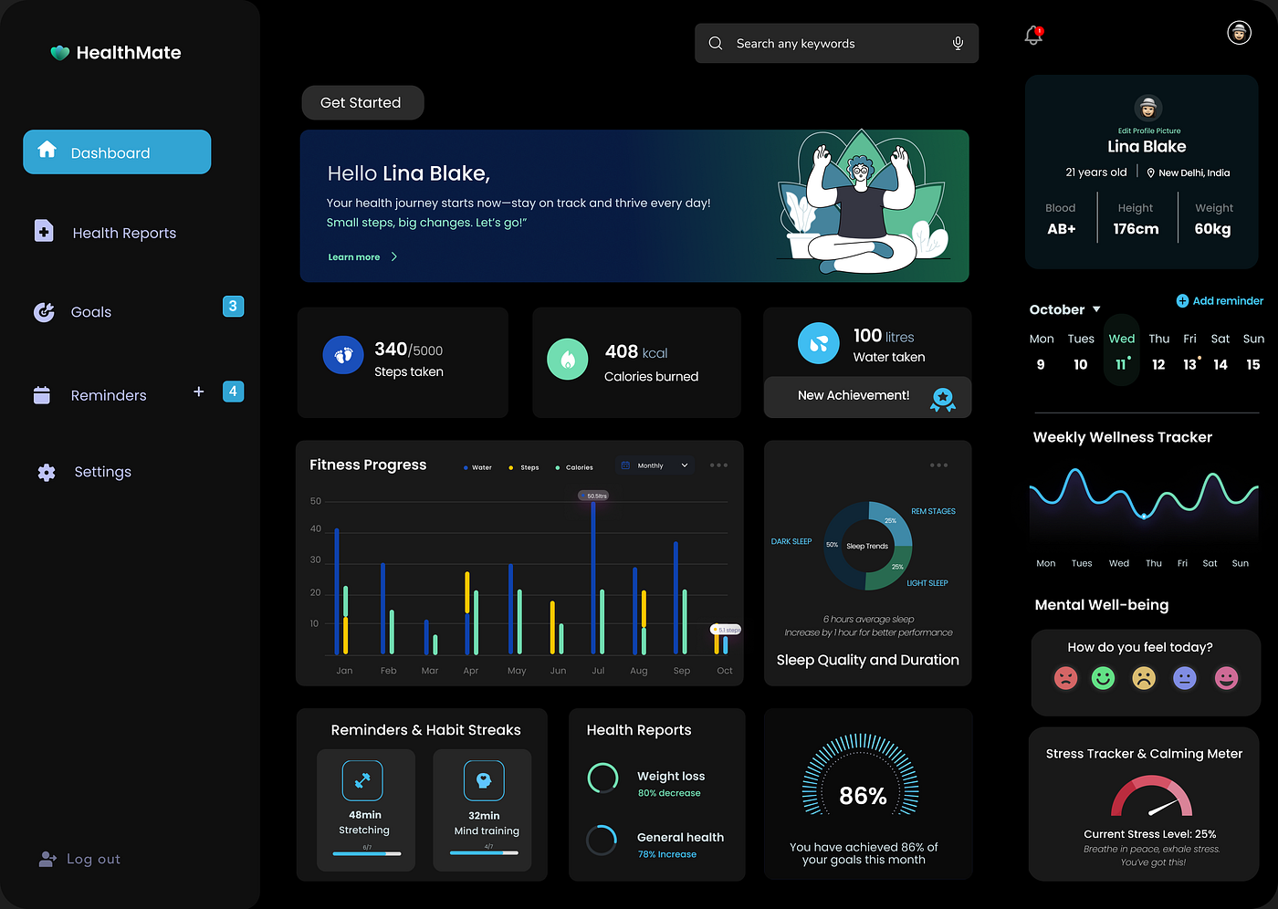
Existing Method
Most existing applications focus on basic health tracking such as steps, heart rate, or calorie count
Use fixed threshold values that are the same for all users
Provide generic insights without understanding individual biological differences
Do not consider cyclic changes in women’s energy and emotional states
Mainly display data on dashboards without intelligent decision making
Limited support for real-time alerts and personalized recommendations

Slide 11


Proposed Method
An AI-driven personalized health and energy monitoring system for women
Uses physiological sensors to collect real-time data (heart rate, temperature, activity)
Employs a hybrid AI agent that combines rule-based logic with learning from historical data
Learns personalized baseline patterns instead of using fixed thresholds
Predicts energy and emotional states rather than only tracking raw data
Provides real-time alerts and personalized recommendations through a mobile application
Focuses on wellness support with an explainable and ethical AI approach

Slide 12
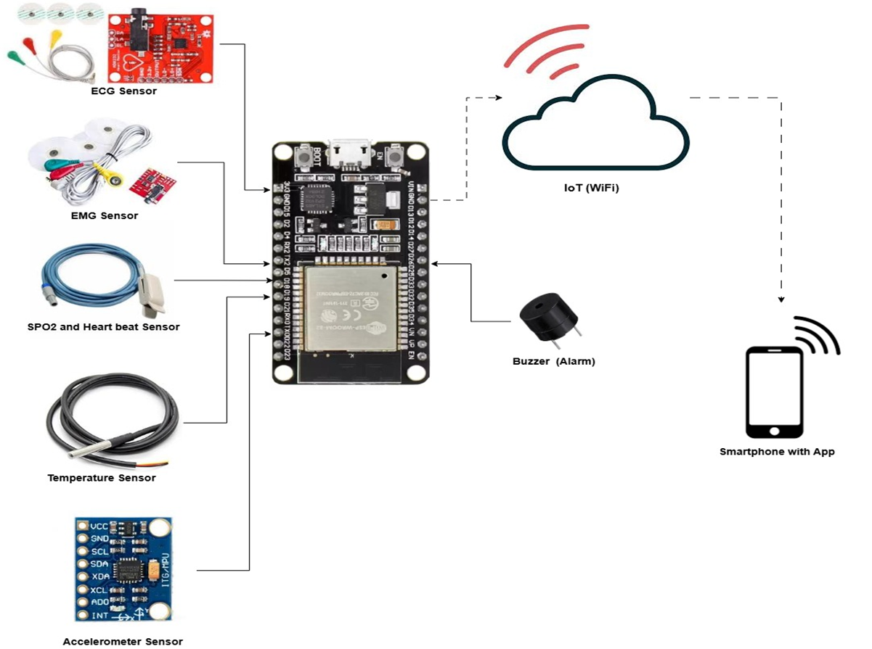
Block Diagram

Slide 13
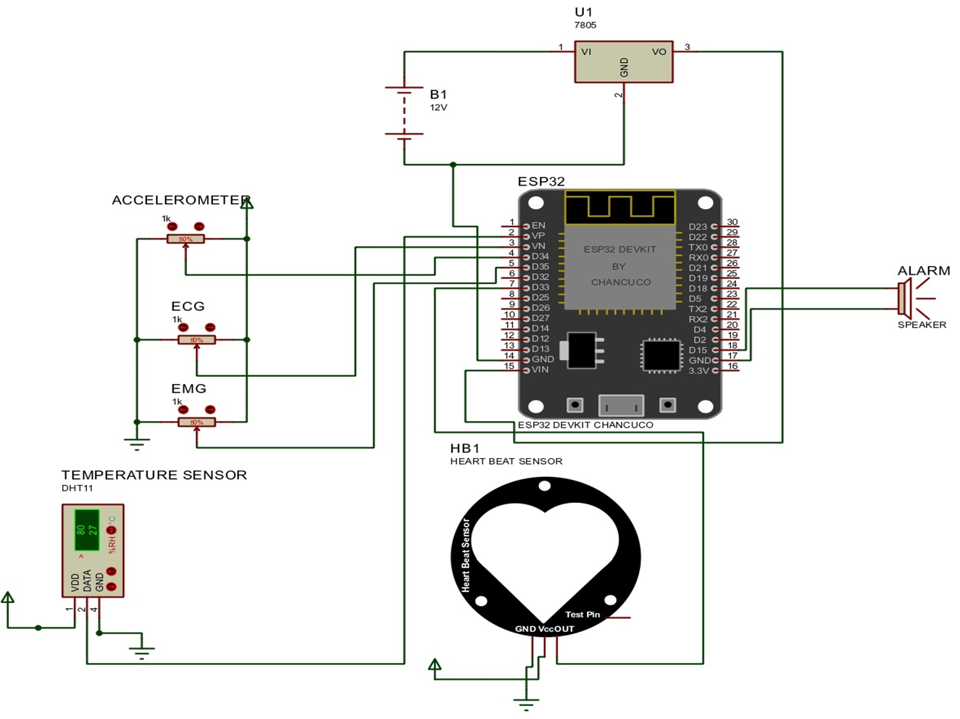
Circuit Diagram​
Fig a) Circuit diagram of Vita guard

Slide 14
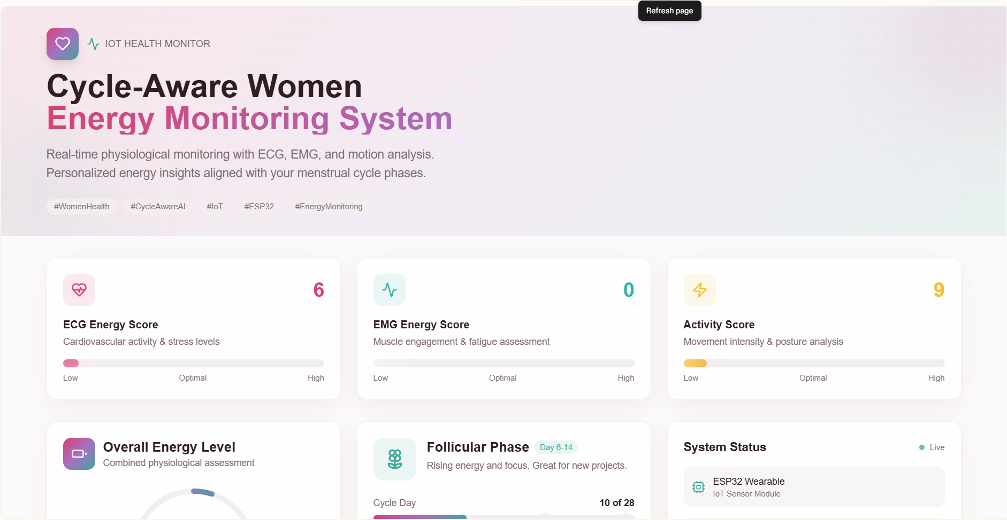
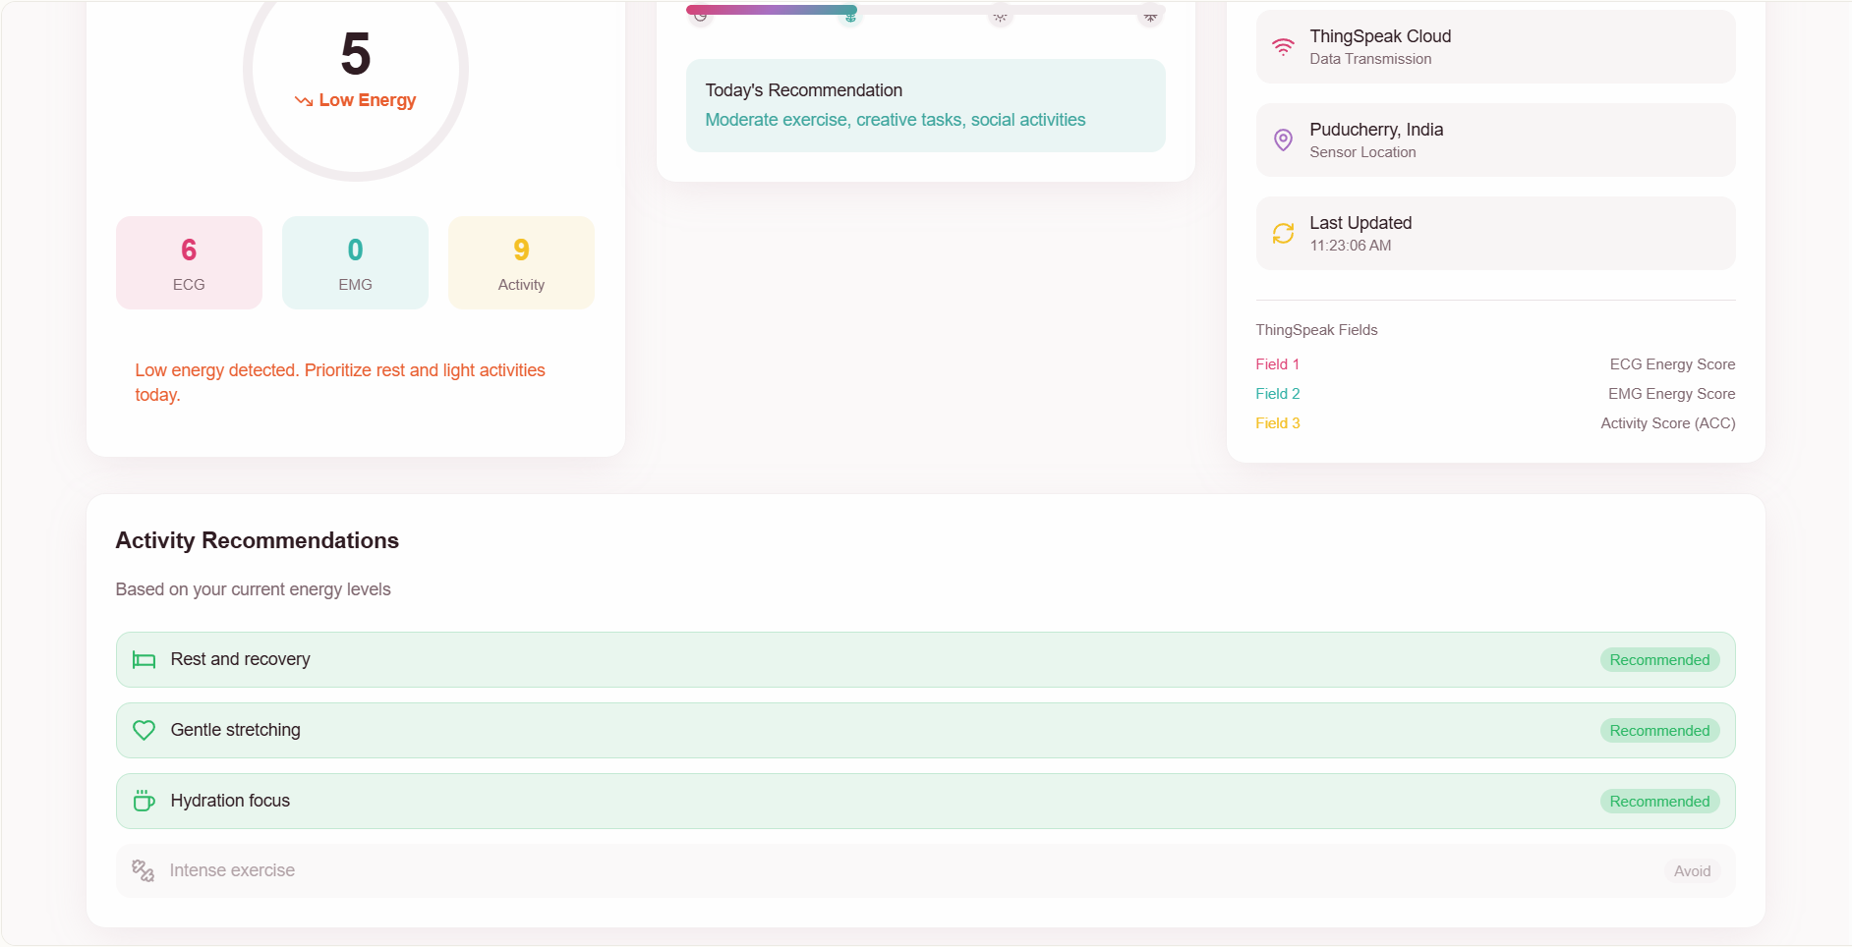
APPLICATION USERFACE

Slide 15
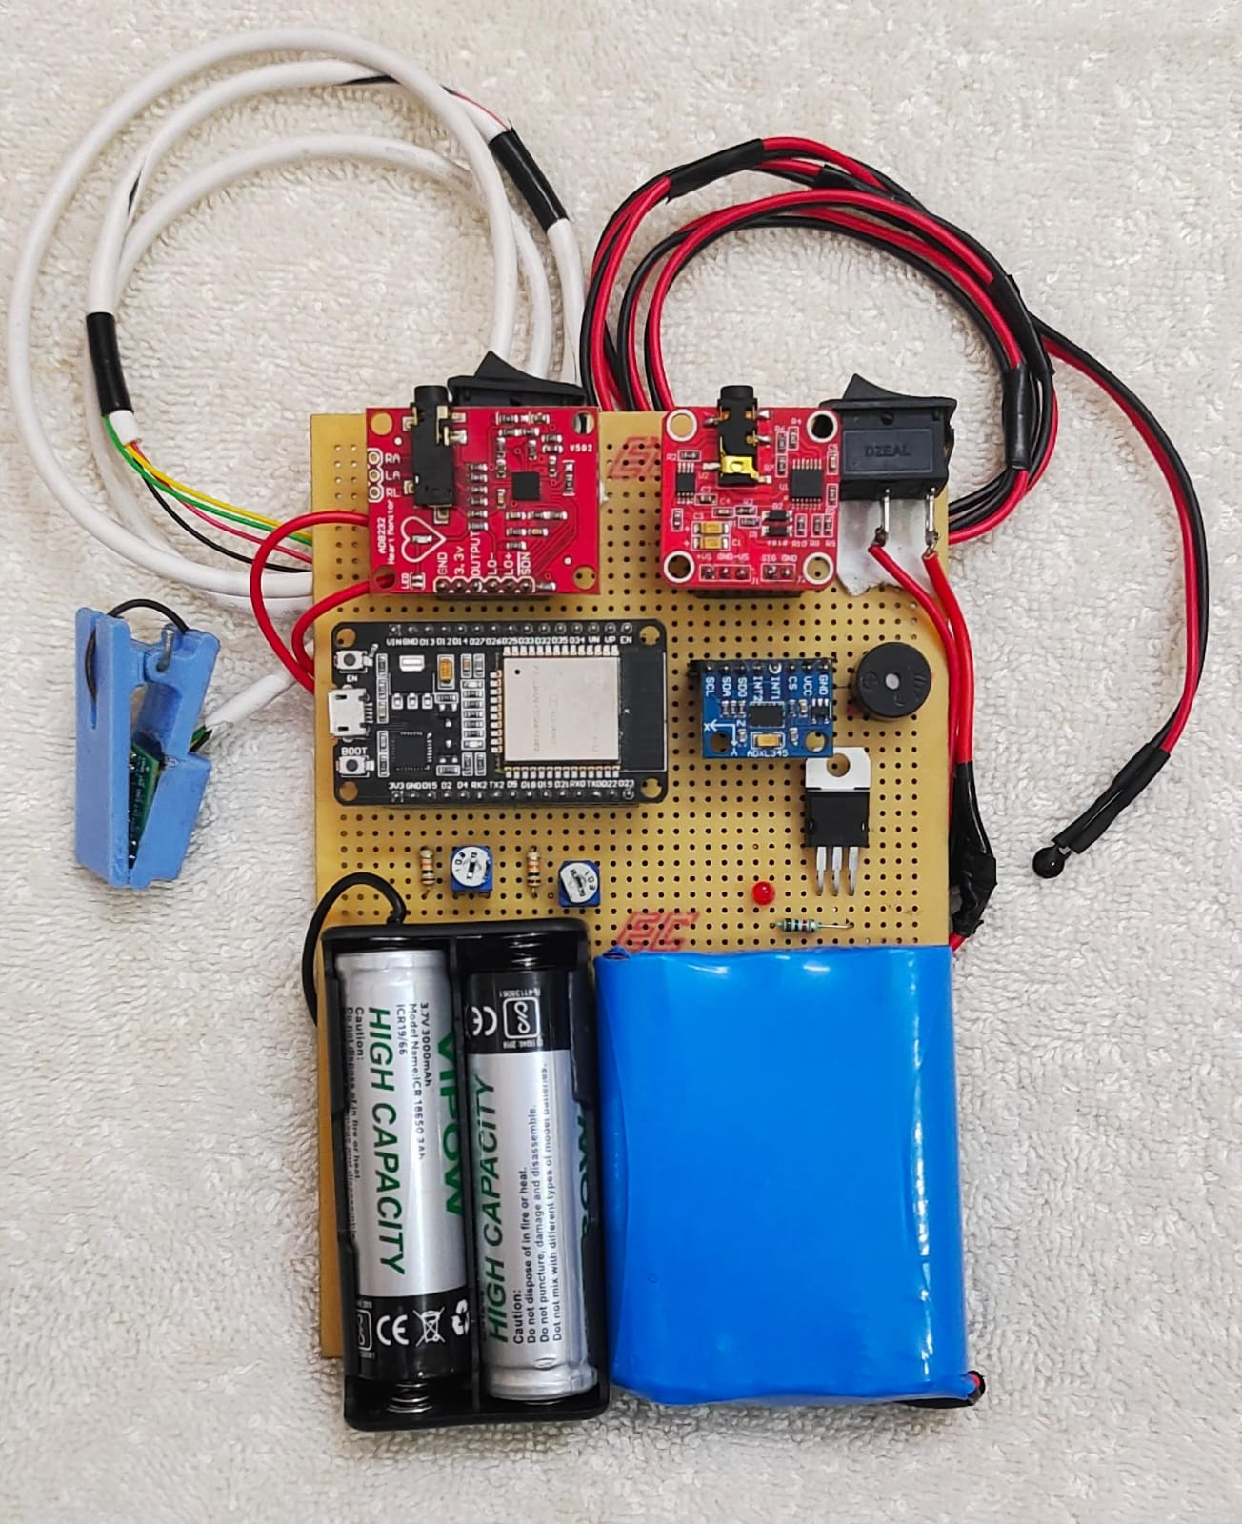
PROTOTYPE IMAGE
EMG Sensor
ECG Sensor
ESP32 Module
Accelerometer
Voltage Regulator
Spo2 and Heartbeat Sensor
Temperature Sensor
Potentiometer
Batteries (12v and 3.7v)

Slide 16
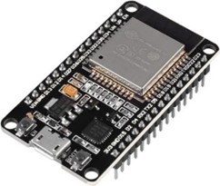
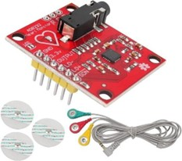
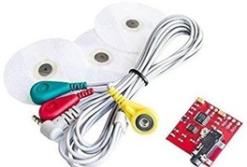
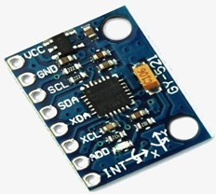
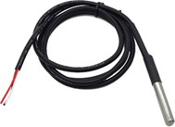
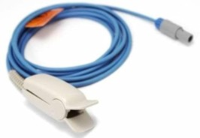
HARDWARE COMPONENTS
ESP 32 Microcontroller
ECG Sensor (AD8232 )
EMG Sensor
Accelerometer Sensor(ADXL345)
Temperature Sensor (LM35/DS18B20)
SPO2 and Heartbeat Sensor

Slide 17
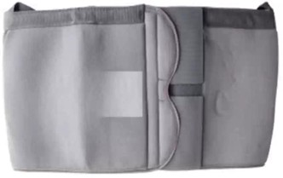
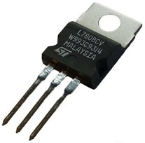
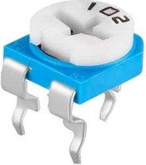
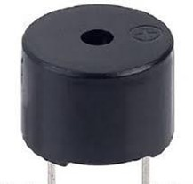
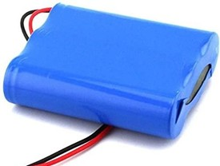
HARDWARE COMPONENTS
Silk Fabric
Voltage Regulator
RM065 Trimmer Potentiometer
Buzzer
Battery

Slide 18
SOFTWARE USED
Arduino IDE
Android Studio
ThingSpeak

Slide 19
REFERENCES
Banerjee, Syagnik, Hemphill, Thomas, and Longstreet, Phil, "Wearable devices and healthcare: Data sharing and privacy," The Information Society, vol. 34, no. 1, 2018, pp. 49-57.
Bin Heyat, Mdbelal, and Siddiqui, Mohd Maroof, "Recording of EEG, ECG, EMG signal," International Journal of Advanced Research in Computer Science and Software Engineering, vol. 9, no. 1, 2019, pp. 1-5.
Caixeiro, T., Čale, D., and Coutinho, C., "Wearable Devices for Health Remote Monitor System," Proceedings of the 2022 IEEE International Conference on E-Health and Bioengineering (EHB), 2022, pp. 1-4.
Canali, Stefano, Schiaffonati, Viola, and Aliverti, Andrea, "Challenges and recommendations for wearable devices in digital health: Data quality, interoperability, health equity, fairness," PLOS Digital Health, vol. 1, no. 1, 2022.
Debnath, P., Mahmud, A., Hossain, A. K., and Rahman, S. M. I., "Design and Application of IoT‐Based Real-Time Patient Telemonitoring System Using Biomedical Sensor Network," International Journal of Advanced Computer Science and Applications, vol. 10, no. 1, 2019, pp. 533-538.
Faisal, Ilham Arun, Purboyo, Tito Waluyo, and Ansori, Anton Siswo Raharjo, "A Review of Accelerometer Sensor and Gyroscope Sensor in IMU Sensors on Motion Capture," Journal of Engineering and Applied Sciences, vol. 14, no. 2, 2019, pp. 452-459.

Slide 20
REFERENCES
Jung, Sang-Joong, and Chung, Wan-Young, "Flexible and Scalable Patient's Health Monitoring System in 6LoWPAN," Sensors Letters, vol. 9, no. 2, 2011, pp. 778-785.
Mansor, Hasmah, Abdul Shukor, Muhammad Helmy, Meskam, Siti Sarah, Quraisyia, Nur, and Zamery, Nasiha Sakinah, "Body Temperature Measurement for Remote Health Monitoring System," in Proceedings of the 2013 IEEE International Conference on Smart Instrumentation, Measurement and Applications (ICSIMA), 2013, pp. 1-5.
Ng Charn Loong, Reaz, Mamun Bin Ibne, and Chowdhury, Muhammad Enamul Hoque, "A Low Noise Capacitive Electromyography Monitoring System for Remote Healthcare Applications," IEEE Sensors Journal, vol. 19, no. 12, 2019, pp. 4340-4348.
Nishitha, K. L., and Ravi Kumar, R., "Health Monitoring System," International Journal of Innovative Research in Science, Engineering and Technology, vol. 9, no. 3, 2020, pp. 1234-1240.
Raorane, R., Wadhonkar, S., Patil, S., and Borole, P., "Health Monitoring System Using Wearable Sensor Network for Workers in Industries," in Proceedings of the 2020 IEEE International Conference on Computing, Power and Communication Technologies (GUCON), 2020, pp. 613-618.

Slide 21
REFERENCES
Samuel, M., and Muthukumaran, R., "Patient Health Monitoring System Using IoT," International Journal of Progressive Research in Engineering Management and Science, vol. 3, no. 2, 2023, pp. 45-50.
Sardini, Emilio, and Serpelloni, Mauro, "Instrumented Wearable Belt for Wireless Health Monitoring," Procedia Engineering, vol. 5, 2010, pp. 580-583.
Sathya, M., Madhan, S., and Jayanthi, K., "Internet of Things (IoT)-Based Health Monitoring System and Challenges," International Journal of Engineering & Technology, vol. 7, no. 1.7, 2018, pp. 175-178.
Senthamilarasi, C., Jansi Rani, J., Vidhya, B., and Aritha, H., "A Smart Patient Health Monitoring System Using IoT," International Journal of Pure and Applied Mathematics, vol. 119, no. 16, 2018, pp. 475-481.
Serhani, Mohamed Adel, El Kassabi, Hadeel T., Ismail, Heba, and Navaz, Alramzana Nujum, "ECG Monitoring Systems: Review, Architecture, Processes, and Key Challenges," Sensors, vol. 20, no. 6, 2020, article 1796.
Sui, Yongkun, Ahn, Chanmin, and Ahn, Chong H., "A New Smart Fall-Down Detector for Senior Healthcare System Using Inertial Microsensors," in Proceedings of the 36th Annual International Conference of the IEEE Engineering in Medicine and Biology Society (EMBC), 2014, pp. 2591-2594.

Slide 22
THANK YOU
37/17

